Slide 1
Project Estimation

Slide 2
Session objectives
Describe and apply several project estimation methods, including Delphi technique, time boxing, top-down estimation and bottom up estimation
Describe and apply several software engineering estimation approaches including lines of code (LOC), function point analysis and COCOMO.

Slide 3
Project Estimation
Once the project deliverables and activities have been defined, the next step in defining the project schedule and budget is to estimate each activity’s duration.
Since a resource generally performs a particular task, a cost associated with that particular resource must be allocated as part of the time it takes to complete that task
The time estimated to complete a particular task will have a direct bearing on the project’s budget as well

Slide 4
Project Estimation Techniques
Guesstimating – Estimation by guessing or just picking numbers out of the air – based on feelings rather than hard evidence. Could be a result of inexperience. Not the best way to drive a project’s budget and schedule. Confidence in these estimates low
Delphi Technique – multiple experts are recruited to estimate the same item, and the results compared. If the estimates are reasonably close, they are averaged to produce an estimate. If not, the estimates are distributed back to the experts to discuss the differences, anonymously, till a consensus is reached.
Time Boxing – a box of time is allocated for a specific activity or task, based more on requirement rather than just guesswork. Once the allocated time is over, work on the particular activity stops.
Advs? Diadvs?

Slide 5
Project Estimation Techniques
Top - down estimating – involves estimating the schedule and/or cost of the entire project in terms of how long it should take or cost. Is a common occurrence resulting from a mandate made by upper management. Once the target objectives are identified, its up to the project manager to allocate percentages to the various project life cycle phases and associated tasks and activities
Bottom-up estimating – involves dividing the project into smaller modules and directly estimating the time and effort in terms of person hours, person week or person months for each module. The WBS provides the basis for bottom up estimating because all the project phases and activities are defined.
Keep in mind that the estimate will be a function of many factors, including the nature of the activity in terms of its complexity and degree of structure, the resources assigned, and support provided including technology, tools, training and the physical work environment.

Slide 6
Software Engineering Metrics and Approaches
Estimating time and effort of the application system provides quite a challenge
Some pointers:
Size – determines the effort in terms of schedule and resource requirements
Complexity – some features and functionalities are more complex than others
Constraints and influencers – includes attributes of the application, processes, people, technology, environment and the required quality of the product

Slide 7
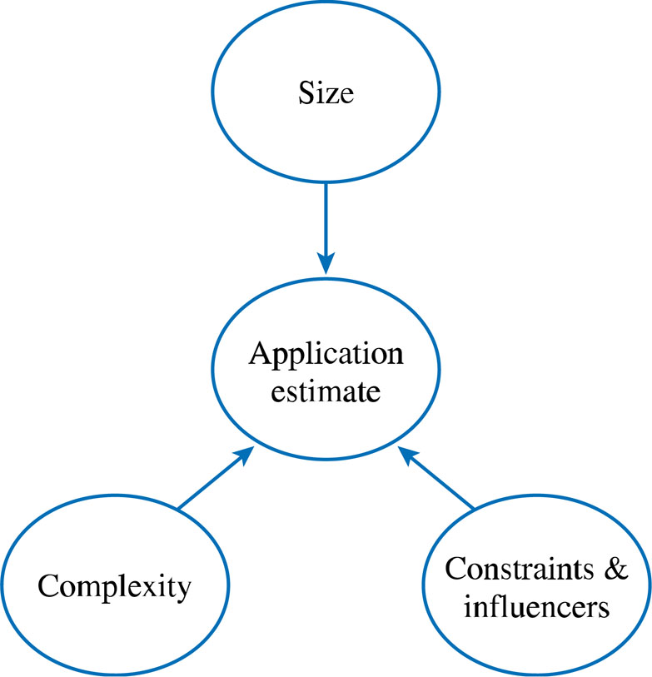
Software estimation model: Adapted from Garmus & Heron 1996, Jones 1998, Royce 1998

Slide 8
Software Engineering Metrics and Approaches -
Lines of Code (LOC) – involves counting the number of lines of code in computer programs in sizing the application product.
Controversial issues:
what counts as lines of code? Comments? Declaration of variables?
Experienced programmers tend to write less code than novice programmers
Also depends on programming languages
It is much easier to count the lines of code after a program is written than it is to estimate how many lines of code will be required to write the program

Slide 9
Function Points
Focus on the functionality and complexity of a application system or a particular module.
Are independent of technology
This metric is very useful for data processing (transaction-processing) systems that are input and output intensive.
Productivity is expressed as the number of function points that are implemented per person-month.

Slide 10
Function Points
Key to counting function points is a good understanding of the user requirements
Function point analysis can be conducted at various stages of the project’s life cycle:
At the scope definition stage
During the analysis and design stages
After implementation to asses if all the functionality was delivered

Slide 11
Function Point Analysis
Based on the evaluation of five data and transactional types that define the application boundary:
Internal logical files (ILF)
External interface files (EIF)
External inputs (EI)
External outputs (EO)
External inquiry (EI)

Slide 12
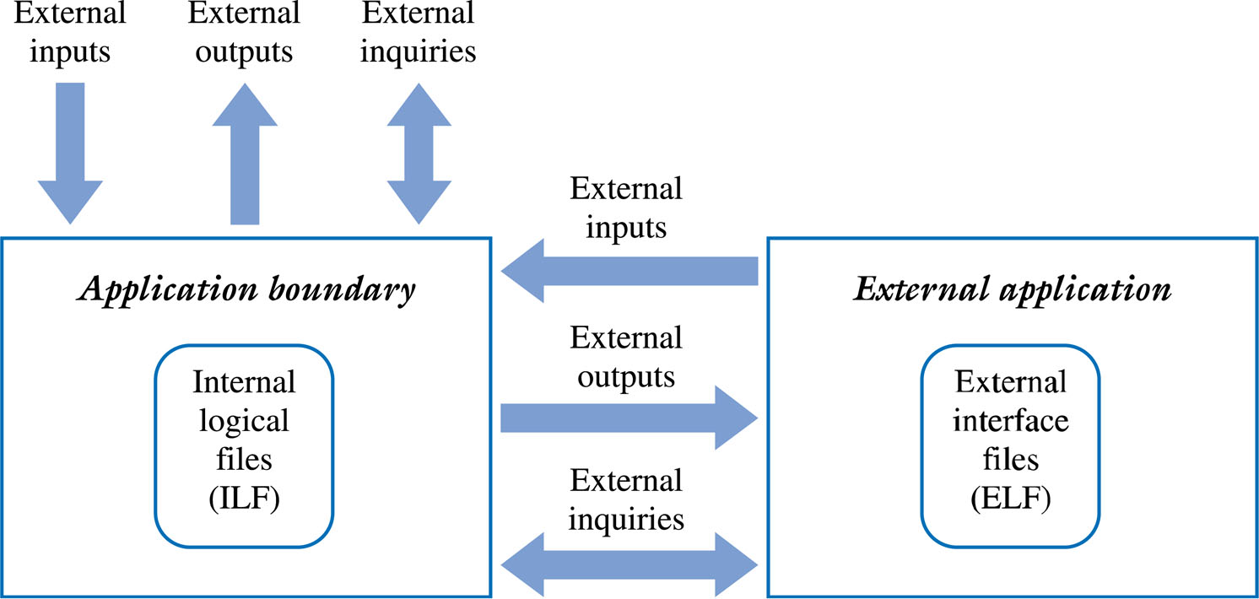
The Application Boundary for Function Point Analysis

Slide 13
Function Point Analysis
Internal logical files (ILF) – stores data within the application boundary. Their complexity classified as low, average or high based on the number of data elements and subgroups of data elements maintained by the ILF. Eg, for an entity Customer, data elements would be customer number, name, address etc. A subgroup would be new customers
External Interface Files (EIF) – similar to ILF, is a file maintained by another application system. Complexity classified as in ILF
External Input (EI) – refers to processes or transactional data that originate outside the application and cross the application boundary from outside to inside

Slide 14
Function Point Analysis
External Output (EO) – is a process or transaction that allows data to exit the application boundary. eg reports, confirmation messages, derived or calculated totals, etc
External Inquiry (EQ) – is a process or transaction that includes a combination of inputs and outputs for retrieving data from either the internal files or from files external to the application. EQ do not update or change any data stored in a file. They only read this information. eg queries. Their complexity is classified as low, average, or high, according to the number of files referenced and number of data elements included in the query

Slide 15
Function Point Analysis
Once all the ILF, EIF, EI EO and EQ are counted and their relative complexities rated, an Unadjusted Function Point (UAF) count is determined
Once assessed for complexity each element is given a weighting value ranging from 3 to 15.
The unadjusted function point count (UFC) is then computed as:
UFC = Sum (number of elements of given type) * weight.

Slide 16
Computing the UAF
Complexity
Low
Average
High
Total
Internal Logical Files (ILF)
_3 x 7 = 21
_2 x 10 = 20
_1 x 15 = 15
56
External Interface Files (EIF)
__ x 5 = __
_2 x 7 = 14
__ x 10 = __
14
External Input (EI)
_3 x 3 = 9
_5 x 4 = 20
_4 x 6 = 24
53
External Output (EO)
_4 x 4 = 16
_2 x 5 = 10
_1 x 7 = 7
33
External Inquiry (EQ)
_2 x 3 = 6
_5 x 4 = 20
_3 x 6 = 18
44
Total Unadjusted Function Points (UAF)
200

Slide 17
Function Point Analysis cont.
The next step in the function point analysis is then to compute a value adjustment factor (VAF).
The VAF is based on the Degrees of Influence (DI), often called the Processing Complexity Adjustment (PCA), and is derived from the fourteen General Systems Characteristics (GSC), that rate the general functionality of the application system(see table in next slide)
To determine the total DI, each GSC is rated based on the following scale from 0 to 5:
0 = not present or no influence
1 = incidental influence
2 = moderate influence
3 = average influence
4 = significant influence
5 = strong influence

Slide 18
General System Characteristic
Degree of Influence
Data Communications
3
Distributed Data Processing
2
Performance
4
Heavily Used Configuration
3
Transaction Rate
3
On-line Data Entry
4
End User Efficiency
4
Online Update
3
Complex Processing
3
Reusability
2
Installation Ease
3
Operational Ease
3
Multiple Sites
1
Facilitate Change
2
Total Degrees of Influence
40
Value Adjustment Factor VAF = o.65 + (TDI /100)
VAF =0.65 + (40 * .01) = 1.05
Total Adjusted Function Points = FP = UAF * VAF
FP = 200 * 1.05 = 210

Slide 19
The calculated function point can be used to estimate lines of code (LOC) depending on the average number of lines of code per function point for a given language.

Slide 20
Language
Average Source LOC per Function Pont
Average Source LOC for a 210 FP Application
Access
38
7,980
Basic
107
22,470
C
128
26,880
C++
53
11,130
COBOL
107
22,470
Delphi
29
6,090
Java
53
11,130
Machine Language
640
134,440
Visual Basic 5
29
6,090
Source: http://www.theadvisors.com/langcomparison.htm

Slide 21
COCOMO
Some Task:
Come up with an ~2 page write up of how the COnstructive COst MOdel (COCOMO) is used in estimating cost, effort and schedule of a software project.

